Slide 1

Data Analysis & Storytelling
- AICTE analyzing the impact of covid-19 on teachers through given data
Name: Netal Daga
Roll no: 271016
College: Vishwakarma Institute Of Information Technology, Pune

Slide 2
OUTLINE
1. Task​
2. Introduction ​
3. Resources​
4. Parameters
5. Results and Discussion​
6. Conclusion and Future Work​
7. References

Slide 3
TASK
Study the given data, analyse it, and prepare the story in the form of presentation.
Focus on the objectives and business intelligence.

Slide 4

INTRODUCTION
Through this presentation, we are trying to show you all how AICTE have analyzed the impact of covid-19 on teaching staff of various colleges/institutes based on different parameters and the visualization.

Slide 5
RESOURCES
Microsoft Excel
Tableau Public 2021.2
Data review sheet
Educational document of questions

Slide 6
PARAMETERS
Impact of COVID-19 pandemic on educational industry.
Analysis of arrangements made by institute for conduction of teacher’s duties in pandemic situation.
Analysis of family crisis and to what extent they are able to overcome on those.
Analysis of improvement in teacher’s skill sets and knowledge during this pandemic.
How many are able to make work-life balance in this on-going situation ?
Analysing learning performance and assessment of students on this digital platform.

Slide 7
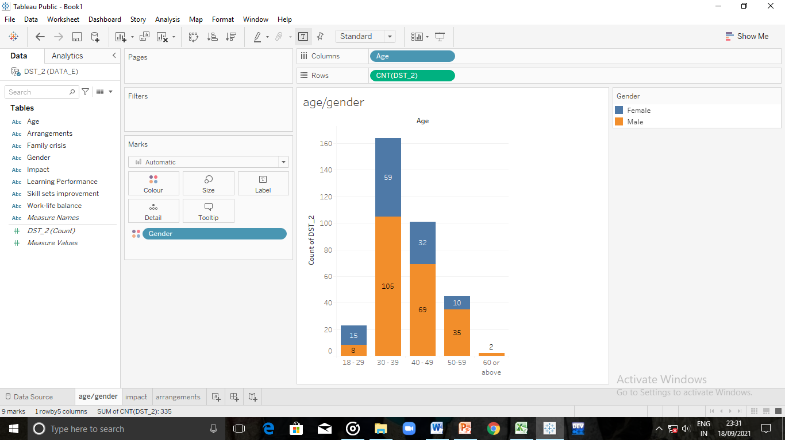
Analysis of age & gender

Slide 8
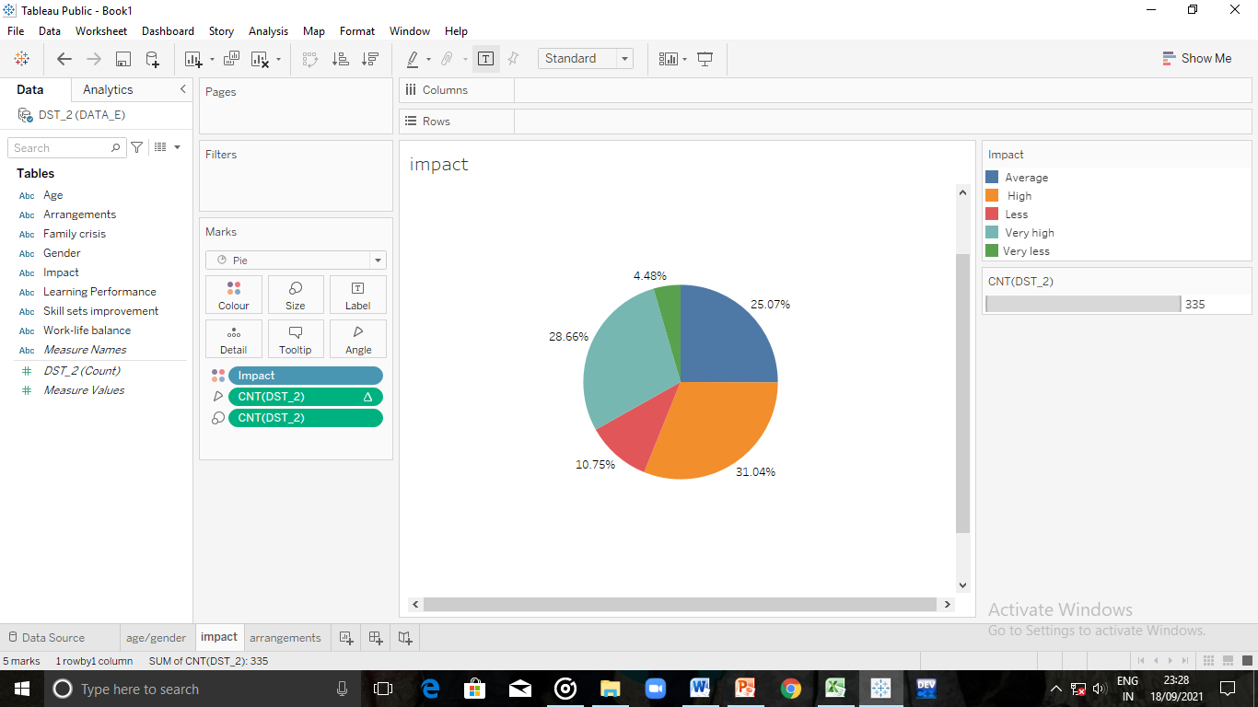
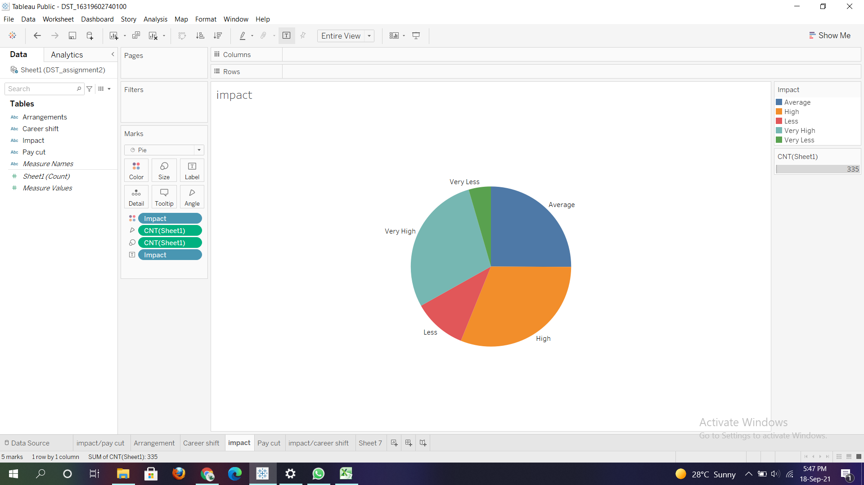
Impact of COVID-19 pandemic on educational industry

Slide 9
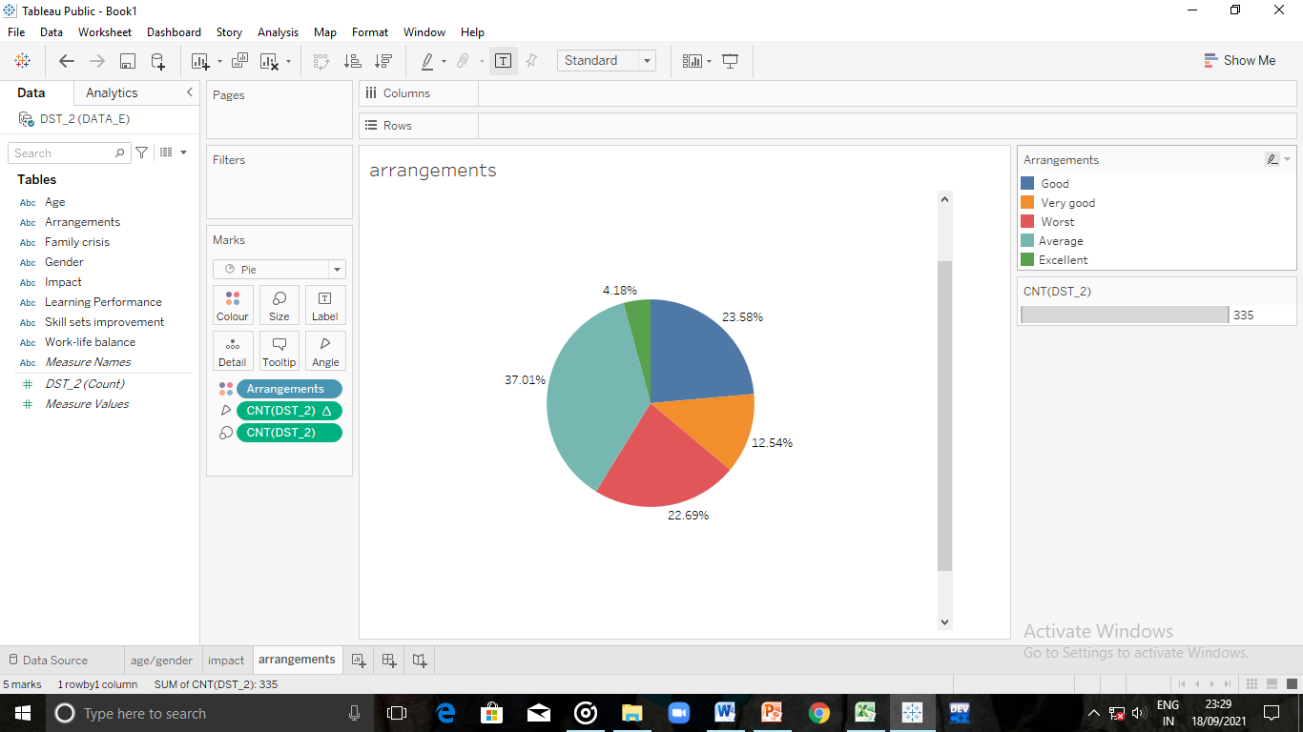
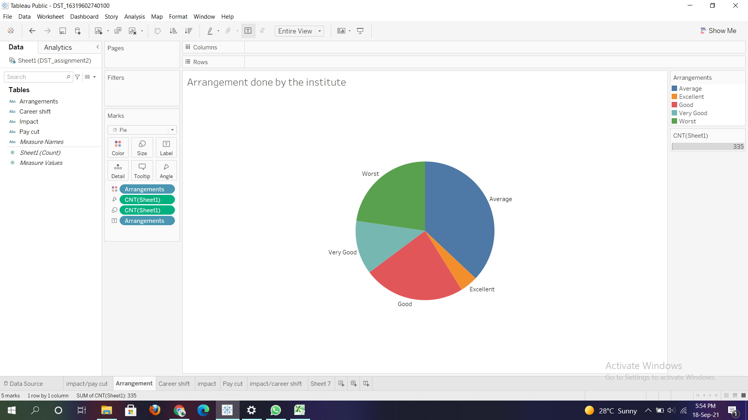
Analysis of arrangements made by institute for conduction of teacher’s duties in pandemic situation

Slide 10
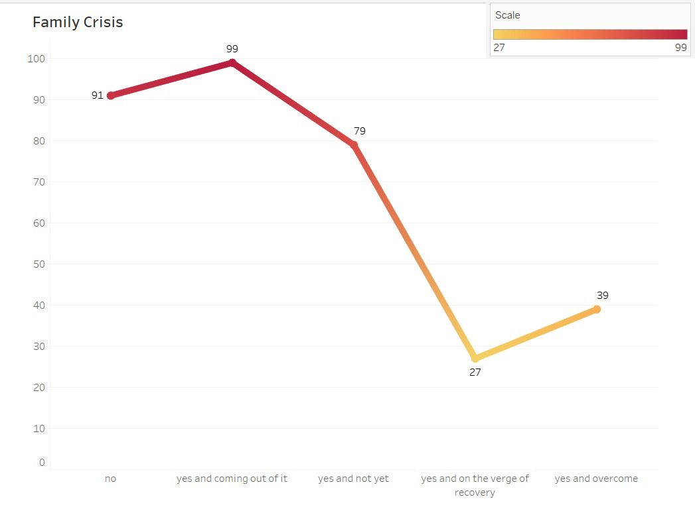
Analysis of family crisis and to what extent they are able to overcome on those.

Slide 11
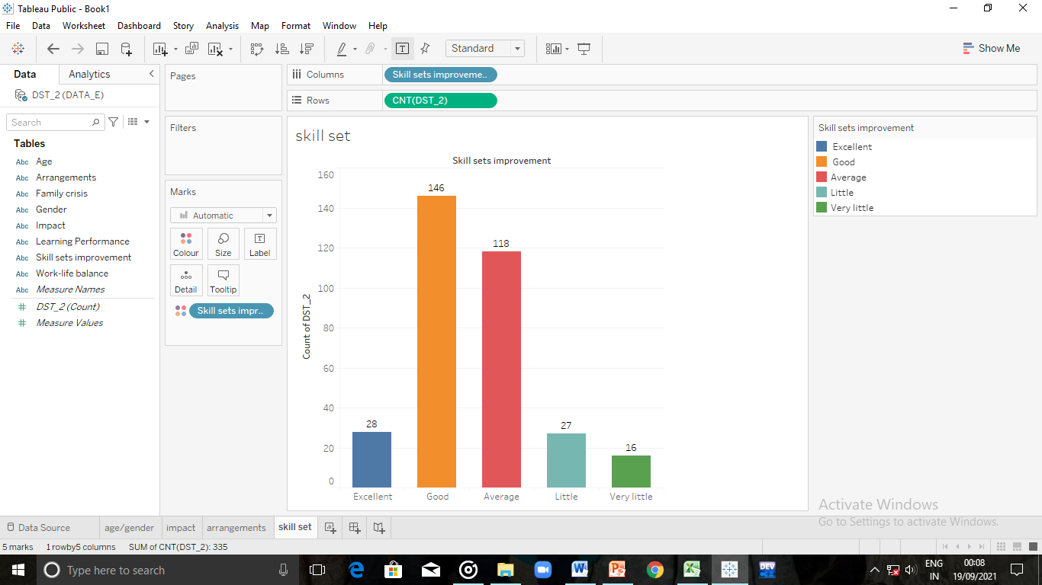
Analysis of improvement in teacher’s skill sets and knowledge during this pandemic

Slide 12
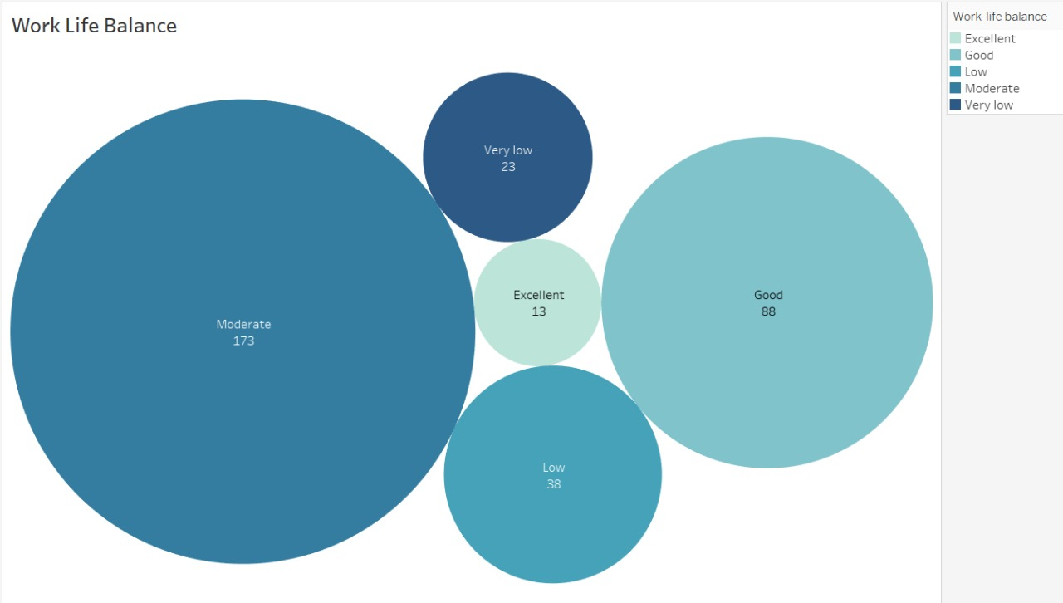
How many are able to make work-life balance in this on-going situation ?

Slide 13
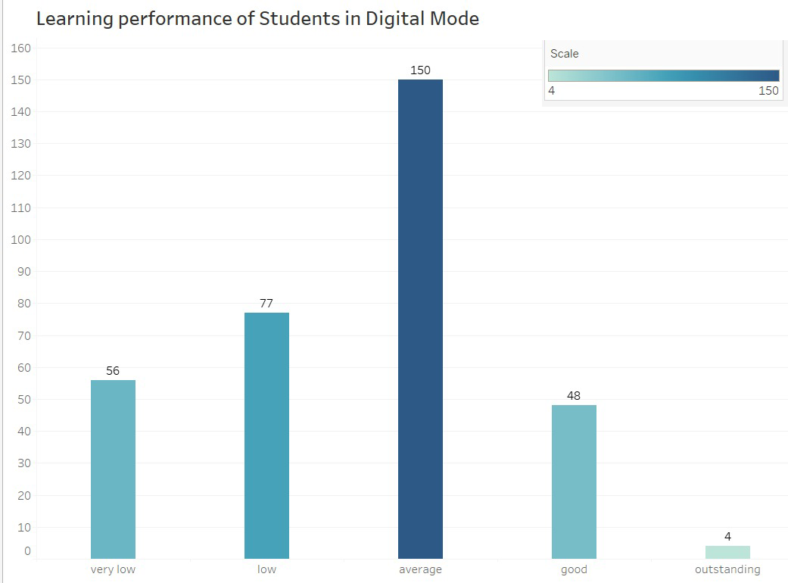
Analysing learning performance and assessment of students on this digital platform

Slide 14
Results and Discussion
1.] Data analysis is done in very good manner with minimum errors.
2.] Attractive and simple visualizations have made the picture more clear.
3.] This data studying would help AICTE to work on particular path for betterment of the teachers.
4.] Now the outcomes need to be discussed and thought up on for improvements in the given aspects.

Slide 15
Conclusion
1.] There is a larger impact of Covid -19 on Education Industry.
2.] Still Institutions and Managements need to focus on better arrangements & facilities to the staff.
3.] Most of the staff has faced family crises amidst of pandemic so some schemes should be planned for their welfare and better future.
4.] There is a majority of ‘moderate work-life balance’ which means this can be improved definitely.
5.] Techers have gained and improved their skill sets on a larger ratio in spite of some limitations which is appreciable.

Slide 16
Future Work
6.] According to teachers there is average learning as well as assessment of the students on digital platform which should be switched as soon as possible along with government guidelines.
Exposure to relevant ICT tools and aids for effective teaching-learning. Training on appropriate use of various modes of evaluation.
Provide resources for lifelong self-learning.

Slide 17

References
Given Dataset .
Given Question Set .

